Slide 1

Intro to VSCode

Slide 2
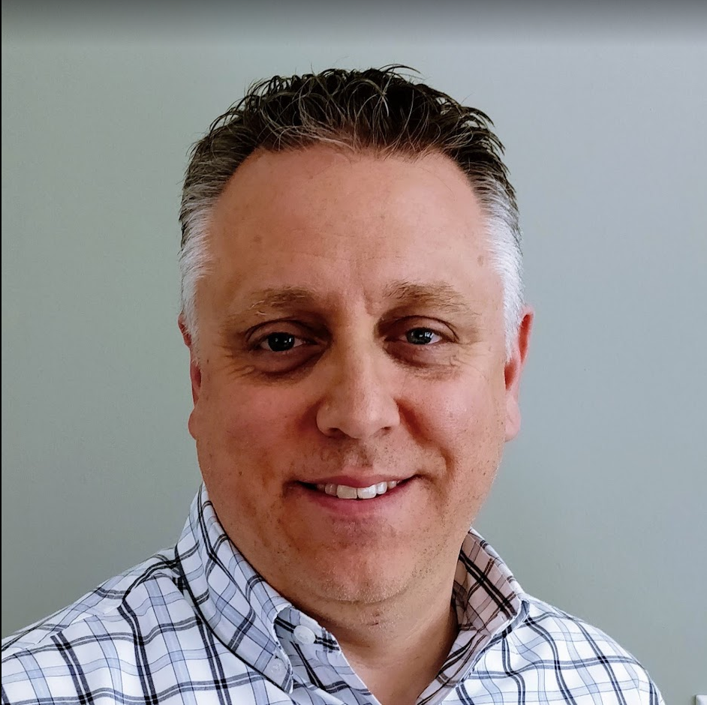
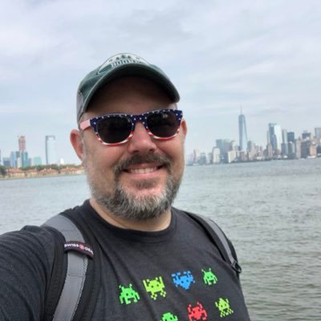
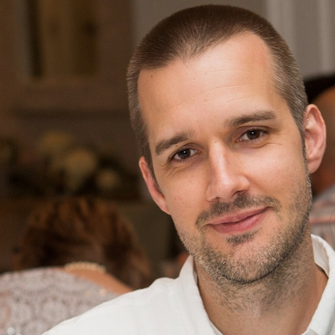
Tonight’s Speakers
Mike Kanakos
Phil Bossman
Kevin Laux

